Slide 1





By Team- Hack & Slash
AGRI-TECH
AGROWW

Slide 2
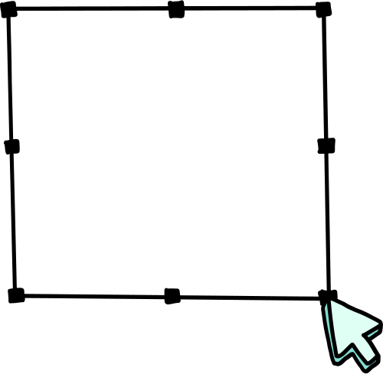

Problem Statement
Enhancing Agricultural Practices through Digital Empowerment
Farmers, especially in rural areas, often struggle to access critical information needed for effective agricultural practices. This lack of access can lead to poor crop selection, missed opportunities to benefit from government schemes, inadequate market access, and insufficient financial planning. Additionally, unpredictable weather patterns and fluctuating market conditions exacerbate these challenges, making farming a high-risk endeavor.

Slide 3

Introduction
Hi there !
We are here to represent an idea which will the people who are facing problems regarding farming or they want to begin their career in farming. We will be forming an WEBSITE which will be including useful instruction, tools, methods regarding farming.
We will be trying to help them out and securing their crops.

Slide 4




1
PROBLEMS AND SOLUTIONS
Problem: Farmers, especially those in remote or underserved regions, often lack access to reliable, up-to-date information about crops, including their ideal growing conditions, pest management, and market value.
Solution: The website can provide a detailed database of crops, including information on soil requirements, climate conditions, common pests, and diseases, as well as best practices for cultivation. This can empower farmers with the knowledge needed to make informed decisions.
1
Lack of Access to Reliable Crop Information
2
2
Difficulty in Accessing Quality Seeds and Inputs
Problem: Farmers may struggle to find high-quality seeds, fertilizers, and other agricultural inputs, which are crucial for achieving good yields.
Solution: The website can feature a marketplace or directory where farmers can purchase certified seeds and inputs. It can also include reviews and recommendations to help them choose the best products.

Slide 5
3
PROBLEMS AND SOLUTIONS
Problem : Many farmers may not be aware of or may not fully understand advanced farming techniques such as drip irrigation, hydroponics, or precision farming, which can significantly boost productivity and sustainability.
Solution: The website can offer educational content, such as articles, videos, and tutorials, on modern farming techniques. It could also provide step-by-step guides and success stories to encourage adoption.
3
Inadequate Knowledge of Advanced Farming Techniques
4
4
Challenges in Pest and Disease Management
Problem: Crop pests and diseases can severely impact yields, and farmers often struggle to identify and manage these threats effectively.
Solution: The website can include a diagnostic tool or a library that helps farmers identify pests and diseases based on symptoms. It can also provide advice on organic and chemical treatments, integrated pest management (IPM) techniques, and preventive measures.

Slide 6
5
PROBLEMS AND SOLUTIONS
Problem : Farmers often face challenges in accessing markets or are forced to sell their produce at low prices due to middlemen and lack of market information.
Solution: The website could include a feature that provides real-time market prices for various crops, helping farmers make better decisions about when and where to sell their produce. It could also offer a platform for direct sales to consumers or businesses, reducing reliance on intermediaries.
1
Market Access and Price Fluctuations
6
2
Limited Awareness of Govt. Schemes and Support
Problem: Farmers may not be aware of government schemes, subsidies, or support programs that could benefit them.
Solution: The website could include a section that provides up-to-date information on relevant government schemes, application processes, and eligibility criteria. It could also offer assistance in applying for these programs.

Slide 7
Crop Recommendations
Buyer Connections
Features of
Govt. Schemes
Website
Weather Updates
Profit/Loss Analysis
Market Trends

Slide 8



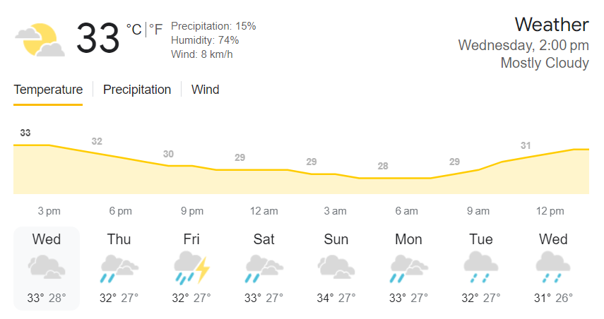
HEADER –this will include profile, contact details, about us, etc.
Picture slideshow related to the topic
REMINDERS
Crop Recommendation
Expenses
Govt. Schemes
Buyer Connections
Market Trends

Slide 9
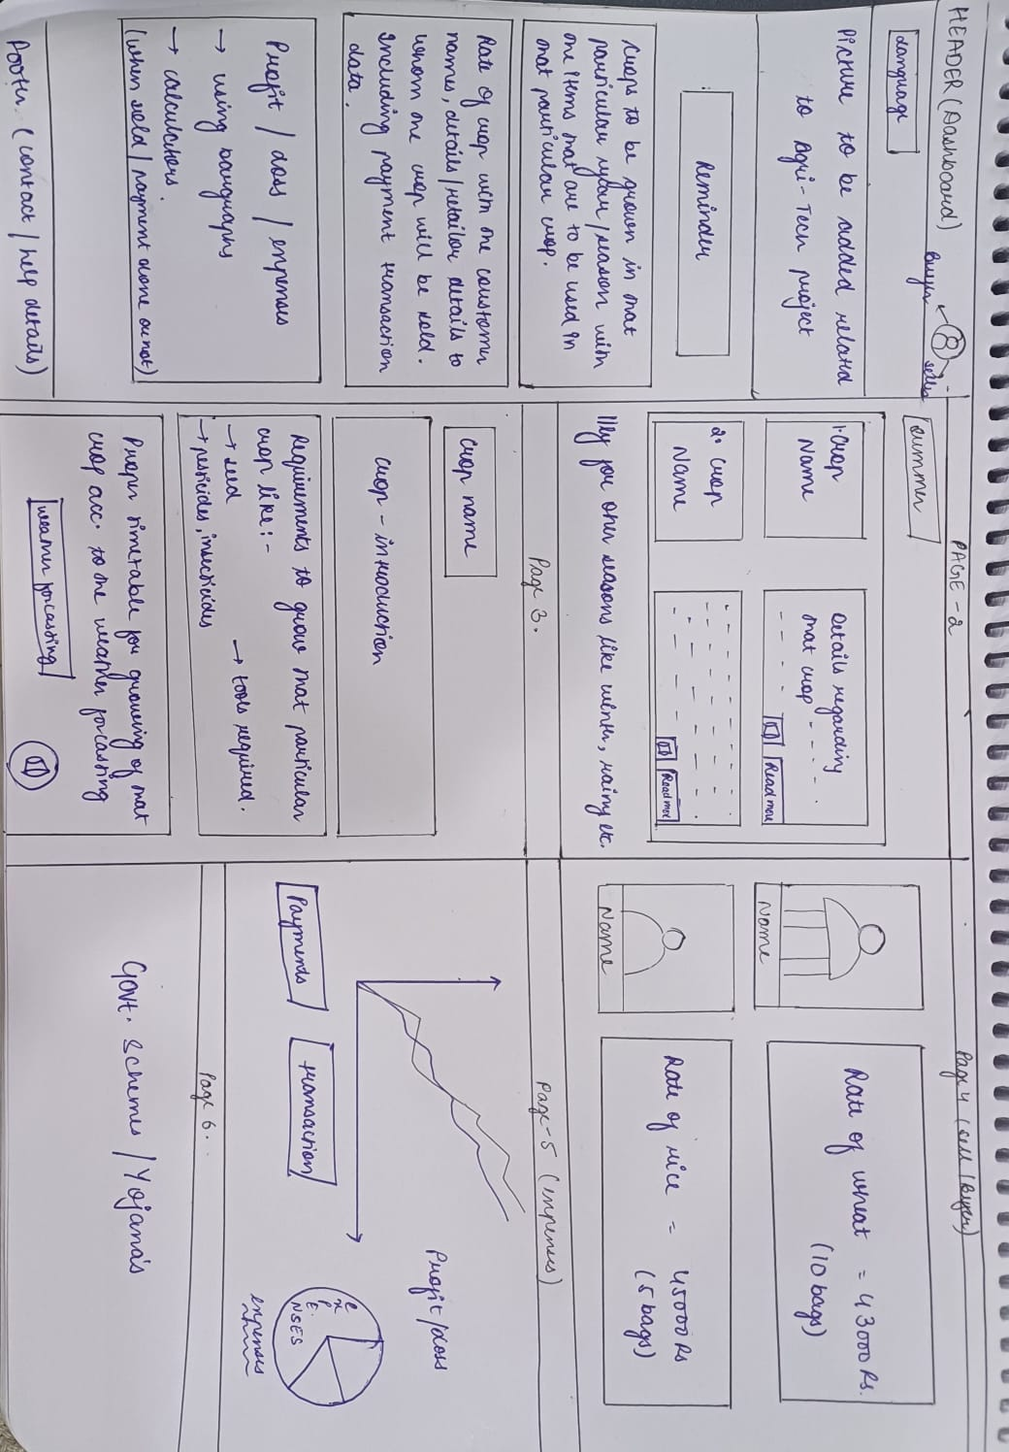

Slide 10
THANK
YOU!

